Slide 1
How to Properly Select & Maintain a Pintle Hitch & Related Components

Slide 2
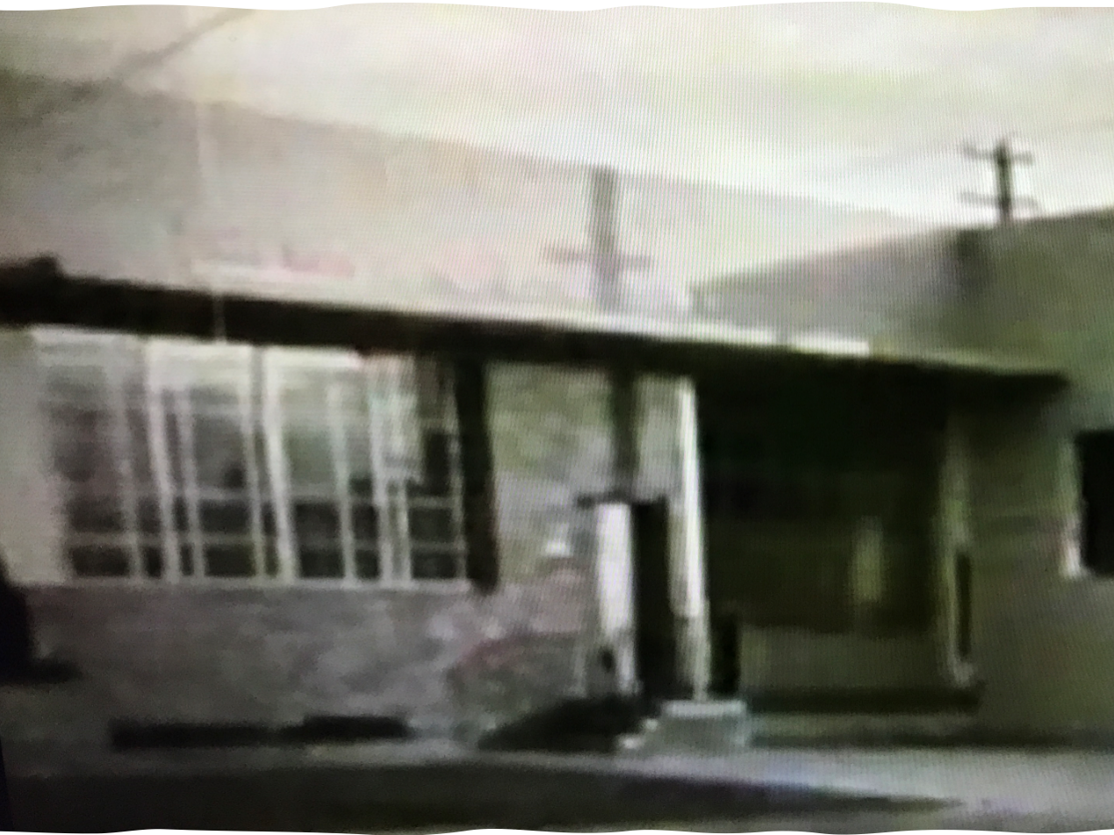
Quick Facts
Founded in 1924
Developed first coupling used in the industry
Over 90 years as the leader in the coupling industry
8 of the top 10 fleets spec Premier
One of only two US manufacturers today

Slide 4
Discussion Today
How to Properly Select & Maintain a Pintle Hitch & Related Components
Pintle Hooks, Drawbar Eyes and Safety Chain Attachment Points
Important note: Understand that these are safety devices

Slide 5
Safety is Priority #1
Coupling Example
X-ray of Poor Manufacturing

Slide 6
Safety is Priority #1
Drawbar Eye Example
Safety Chain Bracket Example

Slide 7
Building to the Core
Proper Selection of Your
Couplings, Drawbar Eyes & Safety Chain Brackets

Slide 8
Starting Foundation
Selecting The Right Equipment
Four Step Process

Slide 9
Definitions
GVWR – Gross Vehicle Weight Rating
Maximum amount of weight the vehicle is able to safely hold and transport
Rated by the manufacturer
Gross Trailer Weight
How much the trailer and payload weighs together
FMVSS – Safety chains or cable and attachment point
If the ultimate combined breaking strength of the two chains is equal to the gross weight of the towed vehicle(s), the requirements are satisfied.
It should be noted that some States may have more stringent requirements for safety chains.

Slide 10
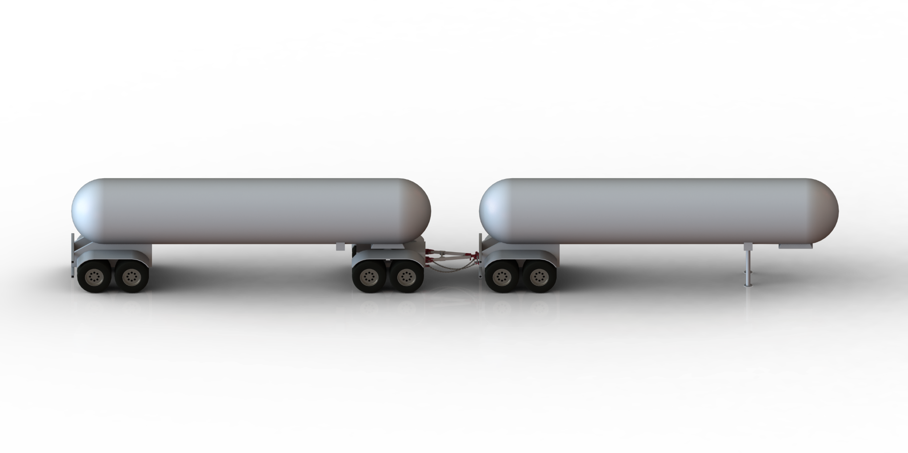
“Gross Trailer (s) Weight” is usually determined by the Gross Vehicle Weight Rating (GVWR)
Step 1 - Determine “Gross Trailer (s) Weight”
This information is attached to the trailer by the trailer manufacturer
40 000 lbs.

Slide 11
Gross Trailer Weight
Only the trailer is considered when selecting your Coupling or Drawbar Eye
Safety Chain Hangers - Must have ultimate strength of no less then the MGTW
Notes:
Poll Question
Are you using cargo D Rings as a safety chain bracket?
Yes
No
Not sure

Slide 12
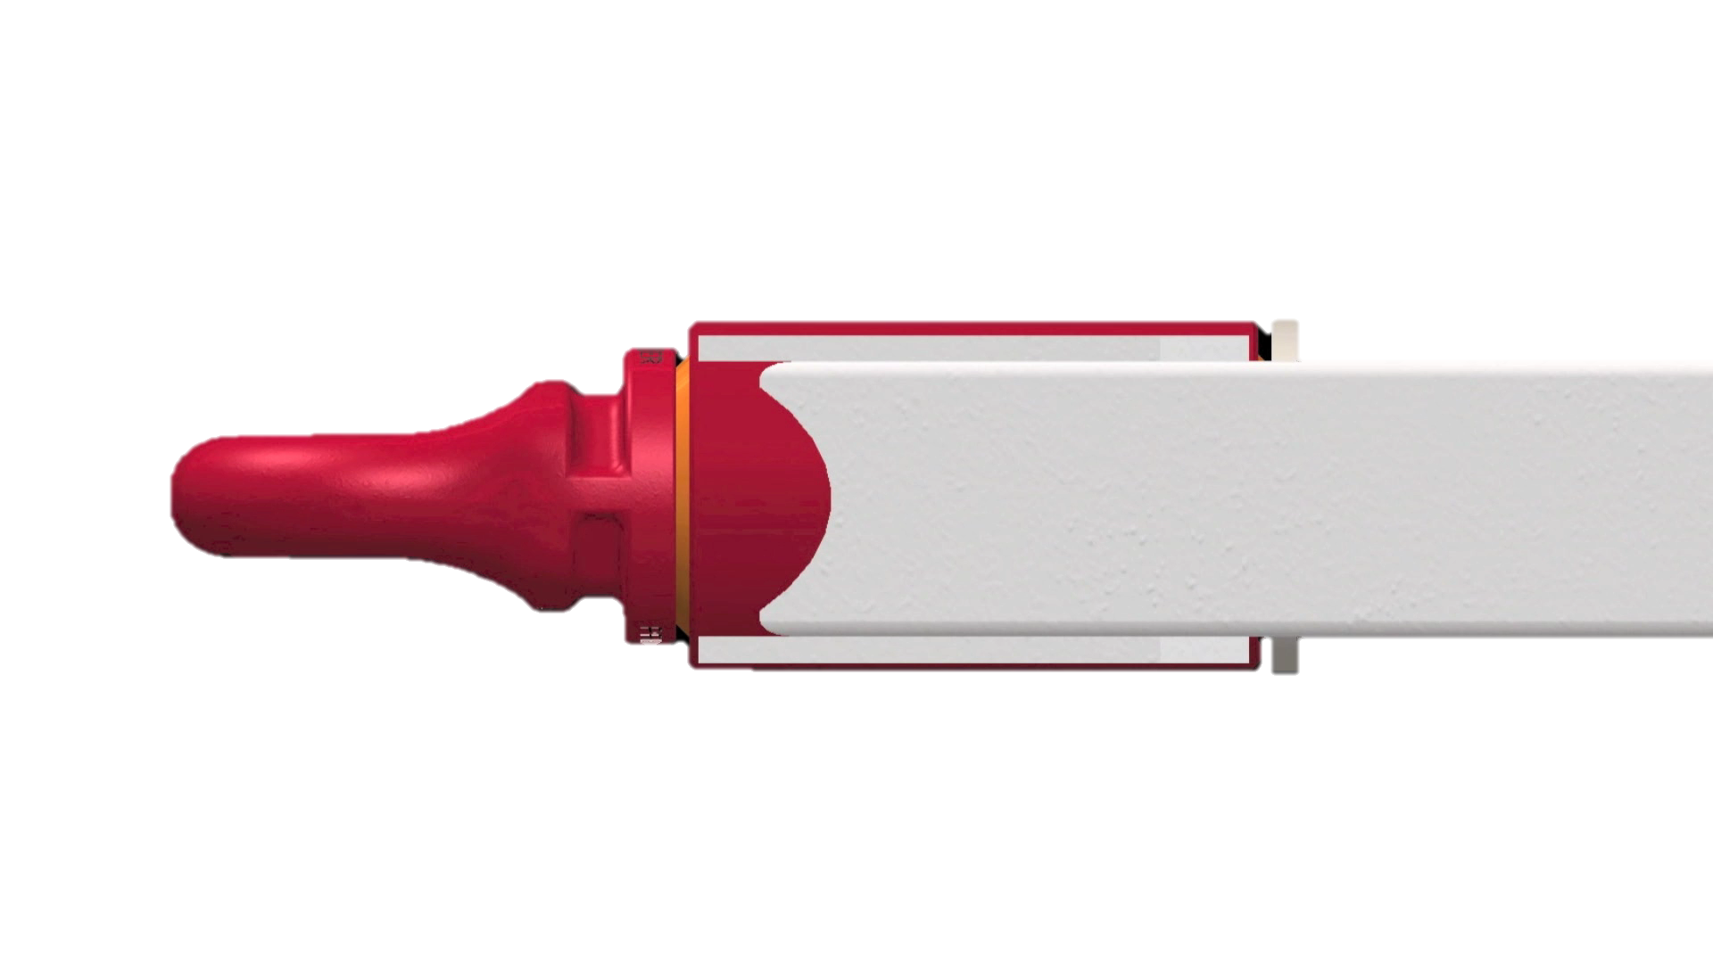
“Tongue Weight Capacity” is the maximum expected weight at the drawbar eye
Step 1 – Determine “Gross Trailer (s) Weight”
Step 2 – Determine “Tongue Weight Capacity”

Slide 13
Tongue Weight
Maximum expected weight at the drawbar eye
Hinged Drawbar – Maximum weight is half of drawbar weight
Non-hinged Drawbar – Weight is not known
Multiply the GVWR of towed trailer by 15%
Best Practice – Weight tongue when trailer is loaded to GVWR

Slide 14
Step 1 – Determine “Gross Trailer (s) Weight”
Step 2 – Determine “Tongue Weight Capacity”
Step 3 – Considering Operating Conditions and Environments

Slide 15
Operating Conditions & Environment
High Priority
Increase Gross Trailer Weight & Tongue Weight Capacity by a minimum of 25%
Some applications require more than 25%
Same practice applies to safety chain brackets

Slide 16
Step 1 – Determine “Gross Trailer (s) Weight”
Step 2 – Determine “Tongue Weight Capacity”
Step 4 – Browse Premier’s or Other’s Product Catalog
Step 3 – Considering Operating Conditions and Environments

Slide 17
Premier’s or Other’s Product Catalog
Browse catalog and refer to “Specifications” section of each product
Review the “Understanding Premier Load Specifications” and “Coupling to Drawbar Eye Cross-Reference” on Premier’s site or catalog for additional resources
Notes:
Poll Question
What brand of pintle hitch do you use today?
Premier Mfg
SAF Holland
Buyers Products
Wallace Forge
Other
I don’t know

Slide 18
Four Steps to Selecting the Right Equipment
Safety Should Be Your Priority Too
When These Connection Points Fail – Fatalities Can Occur

Slide 19
Core line descriptions
Step 1 – Determine “Gross Trailer (s) Weight"
Step 2 – Determine “Tongue Weight Capacity”
The Core – Understanding Dynamic Forces
Step 4 – Browse Premier’s or Other’s Catalog
Step 3 – Considering Operating Conditions and Environments

Slide 20
Understanding Dynamic Forces
The
Core
Idea
How they influence component selection
Static vs. Dynamic Loads
Understand your working conditions and respond accordingly
Personal Preferences
Peace of mind

Slide 21
Dynamic Forces

Slide 22
How Different Are Dynamic Forces?
A static load is just that, “Static”
A 2000 lbs. body exerts 2000 lbs. of force on whatever it is sitting on
Dynamic load conditions (kinetic energy)
Depend greatly on the operating environment
E.g. 2000 lbs. weight traveling at 30 mph – kinetic energy equates to 60113 ft.-lbs.

Slide 23
Dynamic Forces In Action
Kinetic Energy (ft.-lbs.)
Velocity (mph)

Slide 24
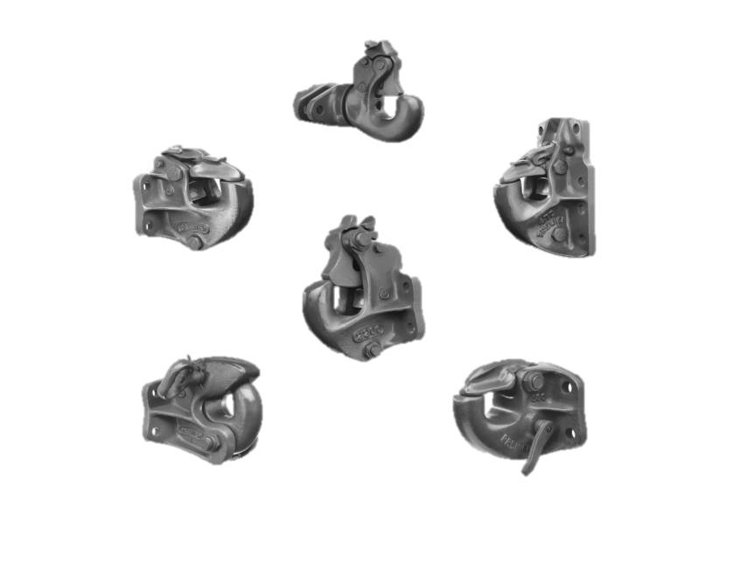
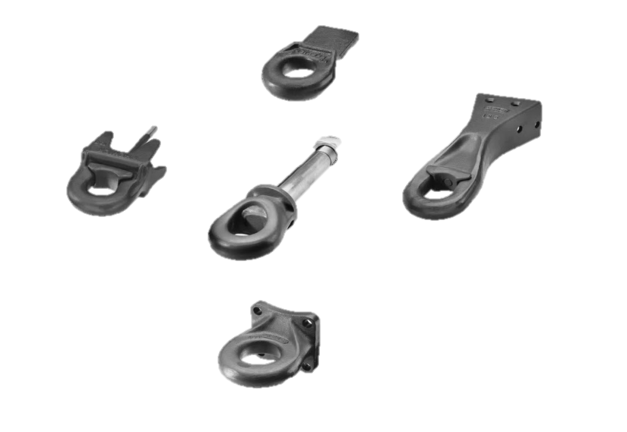
Personal Preference
Selecting Components
Many factors can contribute to successful selection
Latch styles
Mounting bolt hole preference
Slack Reducing System
Saf-Tite or Premalloy
Weld-on or bolt-on
Inside diameter
Rubber or poly bushings
To swivel or not to swivel

Slide 25
Question and Answer
Notes:
With all the competitive options available – why would I choose Premier Mfg over the others?
2. It looks like you’ve shown your competitors products, what assurance can you give me that Premier will last longer and is safer when the specs seem so similar?
3. If I want help specing my equipment, do you have a product expert that can meet with me? Is that via phone or in-person?
I know the capacities are typically different if I drive off-road. What’s Premier’s stance on this?
5. How do I know when my coupling components are out of service?

Slide 26
Find More Information At:
www.minimizer.com
www.highbarbrands.com
www.highbarbrands.com/training

Slide 27
Thank You!
www.premier-mfg.com

